Slide 1

HOME CARE

Slide 2

WHAT TO SCENT?

Slide 3
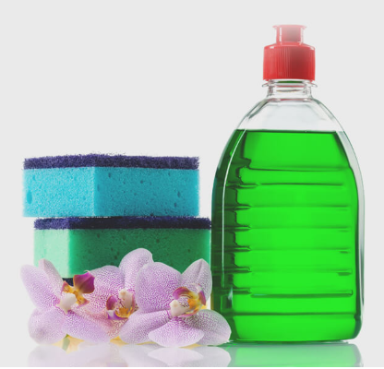
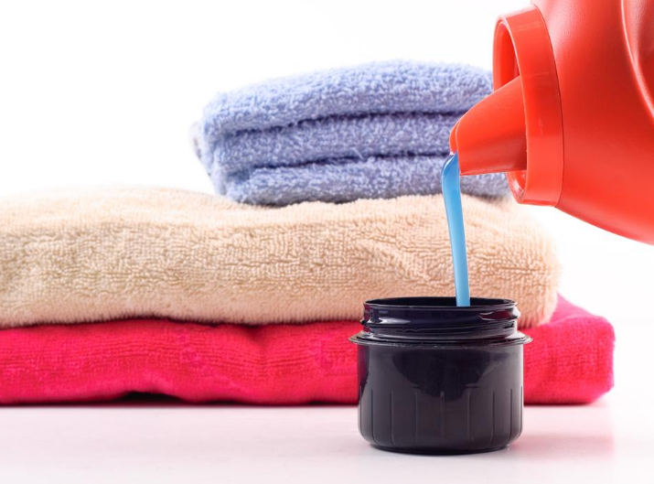
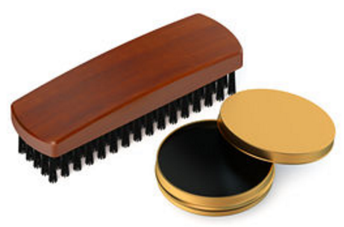
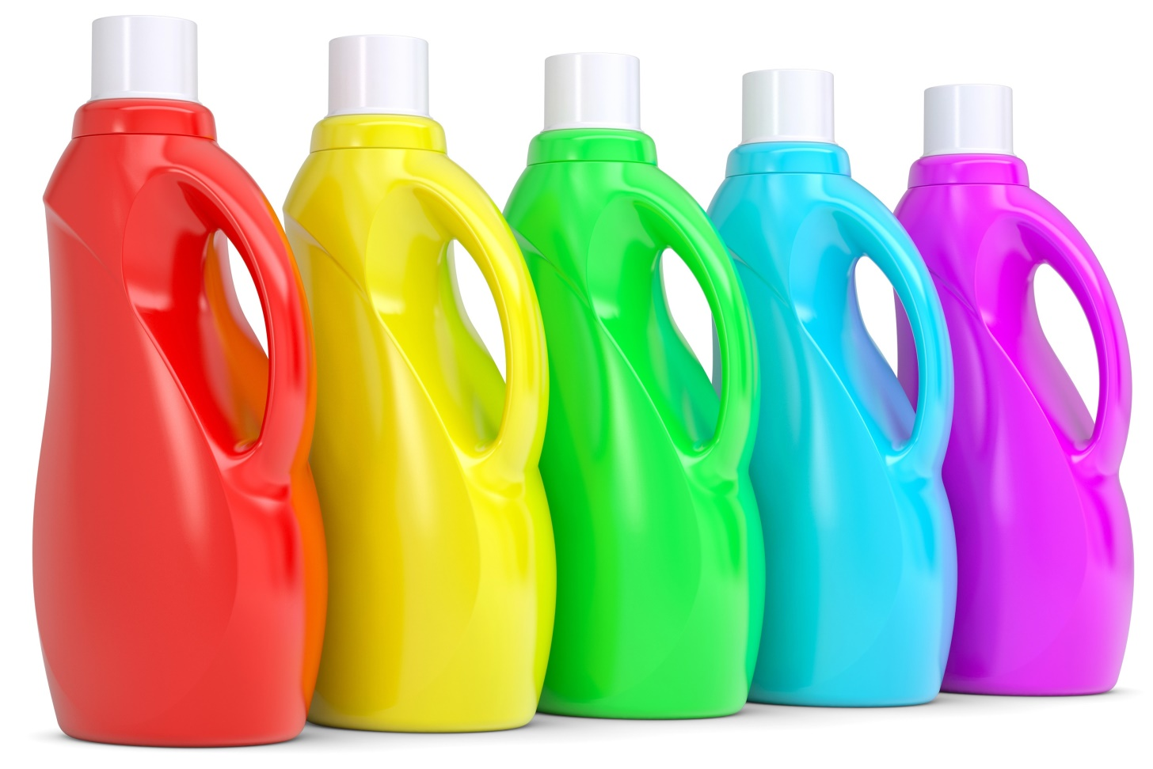
What to Scent?
HOME CARE PRODUCTS:
Dish Wash
Fabric Softener
Liquid & Powder Detergents
Others: Shoes Polish, Plastic bags…

Slide 4

WHY TO SCENT?

Slide 5


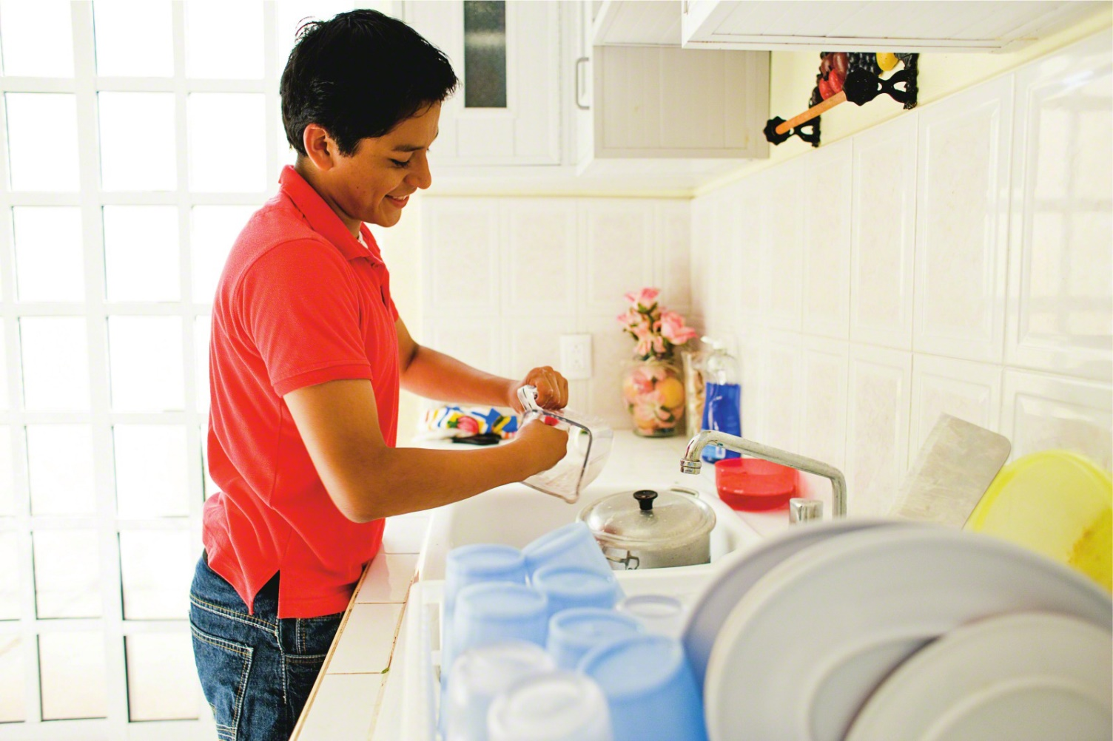
Why to
Scent?
CUSTOMER VALUE
In an effort to stand out on increasingly crowded shelves, marketers are paying close attention to product perfumery and the feelings that fragrances evoke in consumers doing daily house chores.
BEFORE
NOW
“I wish I was in Maldives”
“I love this mystique scent”

Slide 6
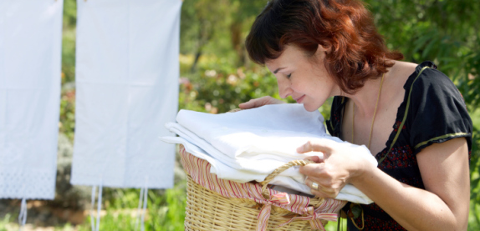
In the last few years, there was a ROBUST DEMAND IN NEARLY EVERY HOME CARE PRODUCT category, especially fabric softeners, for increasingly:
Sophisticated scents
Longer lasting
Highly diffusive fragrances

Slide 7

HOW TO SCENT?

Slide 8

How to
Scent?
Head notes
Heart notes
25%
25%
15%
30%
Long-lasting notes
60%
45%
Fabric Softener
Multipurpose/Disinfectants
Applications | Dosage
Emulsions | 0.1-1%
Detergents | 0.1-1%
Fabric Softeners | 0.1-1%
Soaps | 0.5-3%
25%
60%
15%
35%
60%
5%
Detergent
Dishwashing Liquid

Slide 9

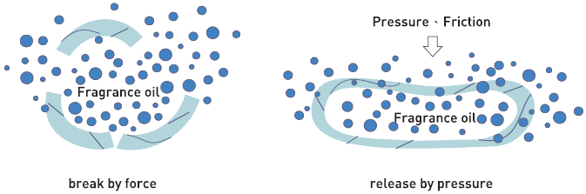
How to
Scent?
TECHNOLOGY
Fragrance encapsulation: keep fabric fresher for longer -> increase consumers’ satisfaction -> potential technology
E.g: Downy Parfum Collection’s Scent-Switcher, Snuggle Scents Booster

Slide 10
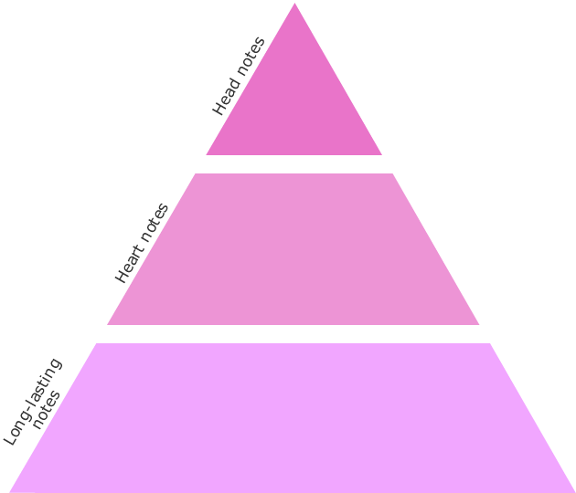
CHEMAROME PROPOSALS
General trends
Specific proposals

Slide 11
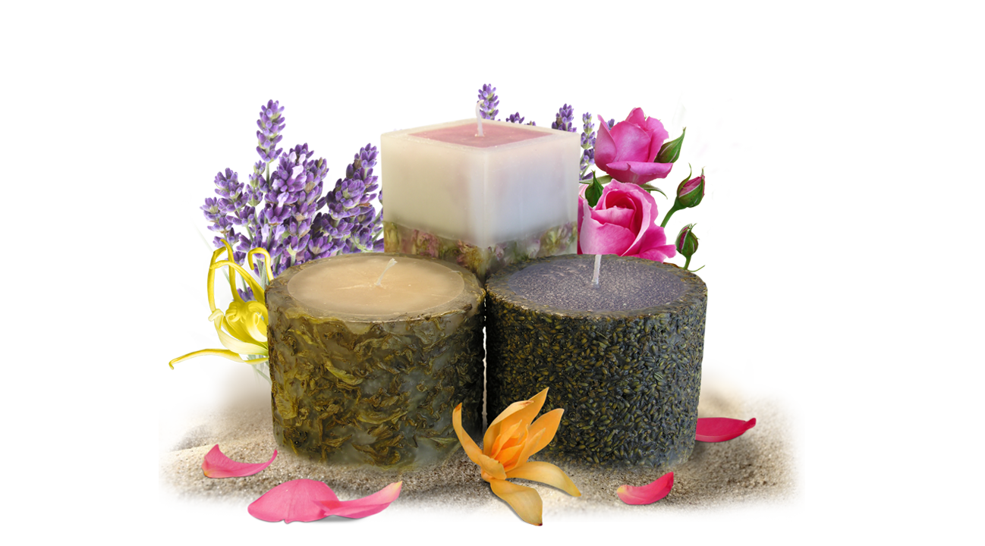
CHEMAROME PROPOSALS: Air Care Inspiration
Chemarome researches the market constantly in search of new trends since the consumer demands are becoming more and more delicate.
Inclusion of more exotic fragrance infusions concepts (used in air care) for fabric softeners.
Creation of the new air care scents related to dream destinations in fabric softener.
Fragrances delivering stress-relief benefits ( spa-like, natural-like ) could help attract consumers.

Slide 12
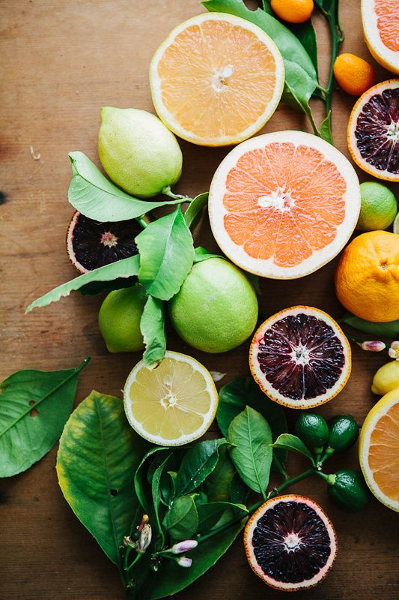

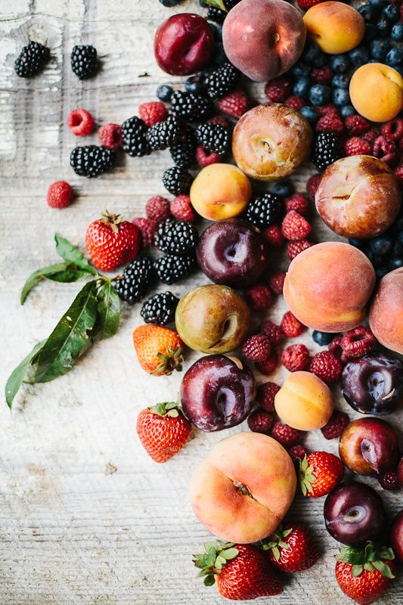
CHEMAROME PROPOSALS: Air Care Inspiration
Common themes of fragrances across all brands:
Floral, Fresh, Light, Fruity, Sweet, Slightly Citrus

Slide 13
CHEMAROME PROPOSALS
What we offer?

Slide 14

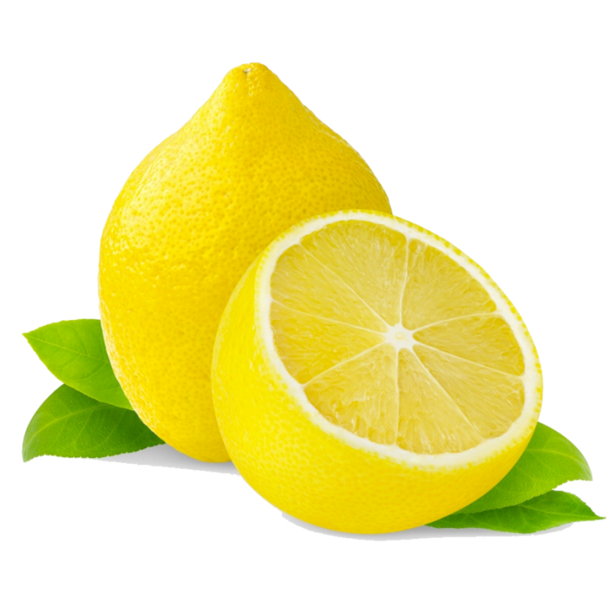
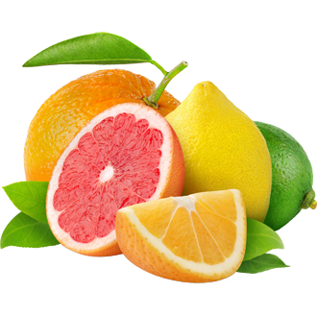
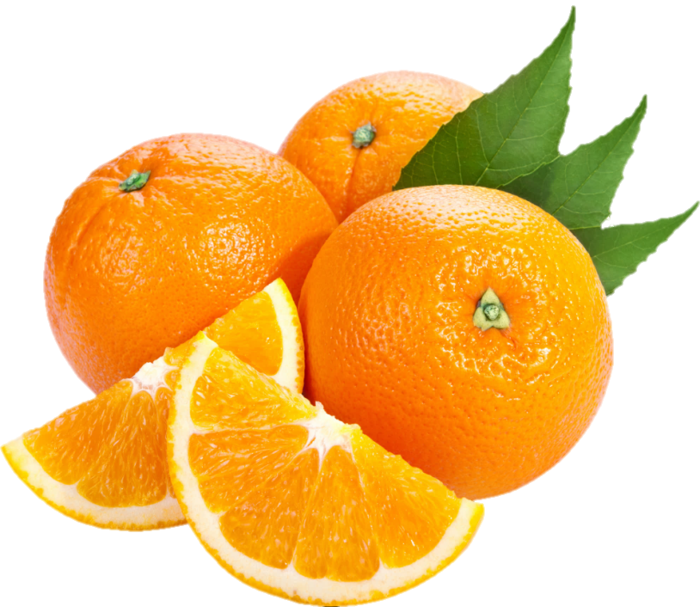
YELLOW LIGHT F/02206/X
A fragrance with citrus and aldehydic notes.
TOP NOTES
OLFACTORY FAMILY:
Aldehyde notes - Lemon - Lime
CITRUS - ALDEHYDIC
APPLICATION:
MIDDLE NOTES
HOME CARE - Dish washing
Aldehydic – Citrus - Lemon
BASE NOTES
Citrus - Fruity - Lemon

Slide 15
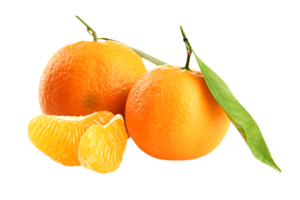
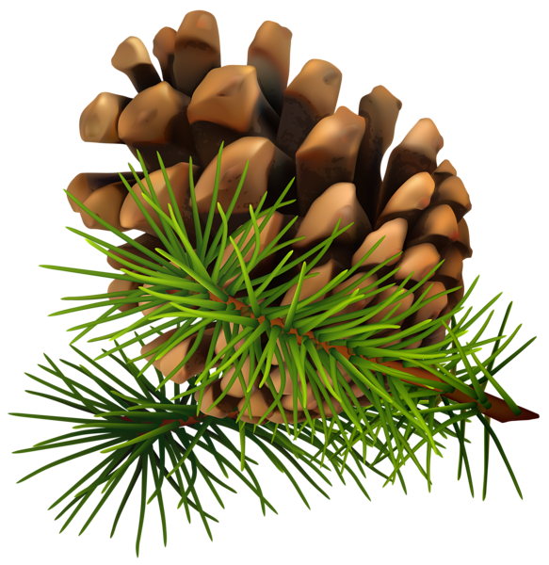
LEMON HOA F/01874/2
A citrus fragrance based in lemon and aldehydic twists.
TOP NOTES
OLFACTORY FAMILY:
Aldehyde notes - Citrus - Pine
CITRUS - ALDEHYDIC
APPLICATION:
MIDDLE NOTES
HOME CARE - Dish washing
Aldehydic – Citrus - Lemon
BASE NOTES
Aldehydic – Fresh - Lemon

Slide 16
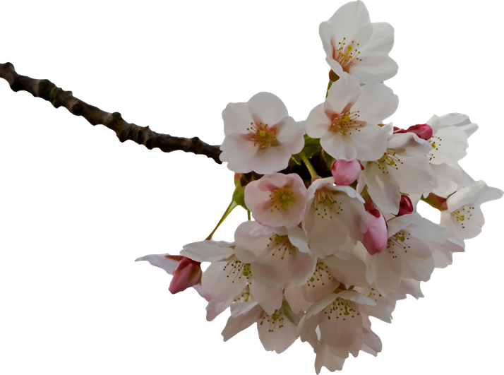
CHERRY BLOSSOM SOFTNER F/04101
Fruity tropical fragrance that evokes a sublime blend between papaya and argan.
TOP NOTES
OLFACTORY FAMILY:
Aromatic - Bergamot - Cherry
FLORAL - FRUITY
APPLICATION:
MIDDLE NOTES
HOME CARE - Fabric Softener
Floral - Mango - Tropical
BASE NOTES
Floral – Musky - Sweet

Slide 17
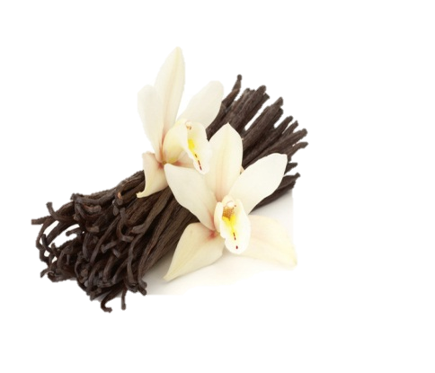
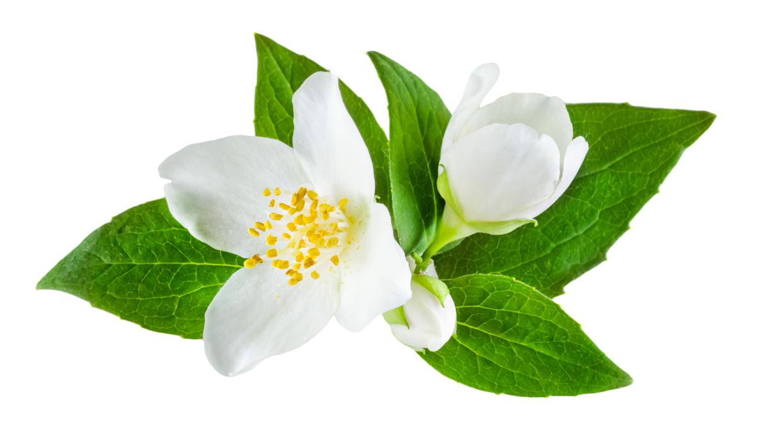
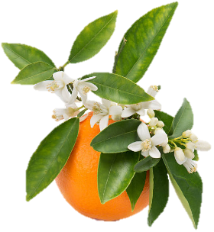
BELLESOFT F/03827/2
Type of La Vie est Belle by Lancome adapted to fabric softener application.
TOP NOTES
OLFACTORY FAMILY:
Black currant - Fruity - Pear
FLORAL - EDIBLE/GOURMAND
APPLICATION:
MIDDLE NOTES
HOME CARE - Fabric Softener
Jasmine - Orange blossom
BASE NOTES
Iris - Praline - Tonka - Vanilla

Slide 18

JASMINE DROPS F/01205/2
A floral fragrance composed by jasmine, white flowers and pinaceous notes.
TOP NOTES
OLFACTORY FAMILY:
Floral - Jasmine - Lily of the Valley
FLORAL - JASMINE
APPLICATION:
MIDDLE NOTES
HOME CARE - Liquid Detergent
Fruity - Lily - Ylang-Ylang
BASE NOTES
Balsamic - Floral

Slide 19
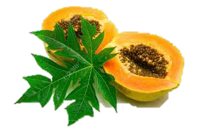
TROPICAL PAPAYA F/01586/I
Fruity blend of papaya and tropical delight note.
TOP NOTES
OLFACTORY FAMILY:
Fruity - Orange - Papaya
FRUITY - FLORAL
APPLICATION:
MIDDLE NOTES
HOME CARE - Liquid soap
Floral – Jasmine - Rose
BASE NOTES
Lactonic – Musky - Woody

Slide 20
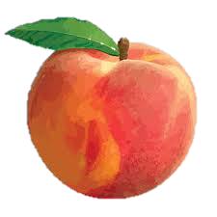
COSMETIC PEACH F/02521/X
A fruity peach creation that recreates the scent of natural peaches. It opens with a juicy apricot note followed by an osmanthus jam heart that is ended by a soft and textured lactonic base..
TOP NOTES
OLFACTORY FAMILY:
Apricot - Fruity - Peach
FRUITY - EDIBLE/GOURMAND
APPLICATION:
MIDDLE NOTES
HOME CARE - Liquid soap
Green - Herbal - Tropical
BASE NOTES
Creamy - Lactonic - Sweet

Slide 21
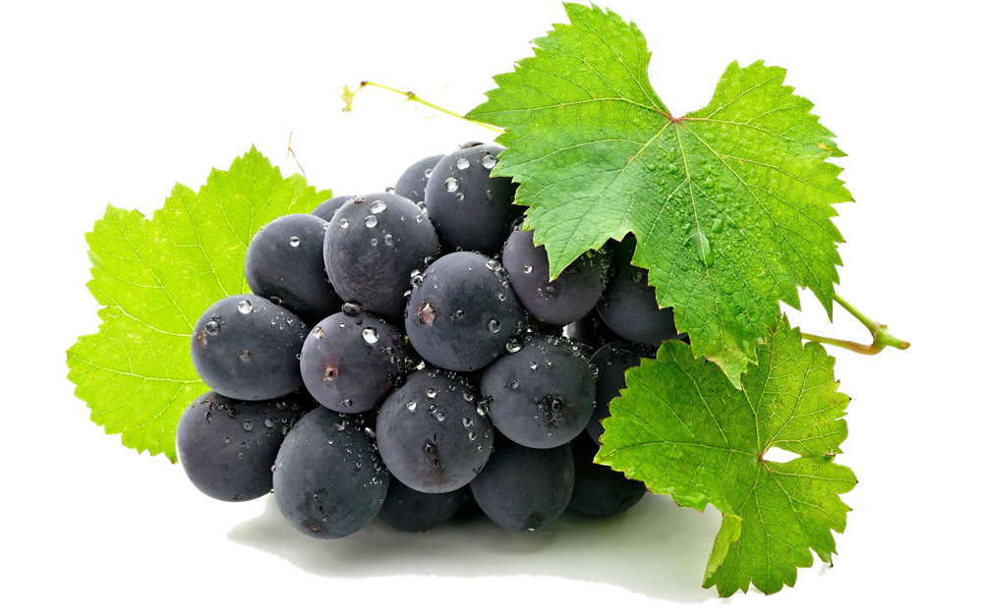
GRAPE F/01687
A fruity fragrance reproducing the juiciness of a fresh and sweet grape note.
TOP NOTES
OLFACTORY FAMILY:
Fresh - Fruity - Neroli
FRUITY - SWEET
APPLICATION:
MIDDLE NOTES
HOME CARE - Liquid soap
Cassis - Fruity - Grape
BASE NOTES
Floral - Fruity - Orange blossom

Slide 22
GRAPE FOR SOAP F/01008
Functional fragrance for application in soap, shampoo or shower gel that combines fruity elements to give as result a fresh tropical grape.
TOP NOTES
OLFACTORY FAMILY:
Fruity - Green - Tropical
FRUITY - FRUITY
APPLICATION:
MIDDLE NOTES
HOME CARE - Liquid soap
Floral - Fresh - Grape
BASE NOTES
Orange blossom - Sweet

Slide 23

TIME TO COLLABORATE

Slide 24
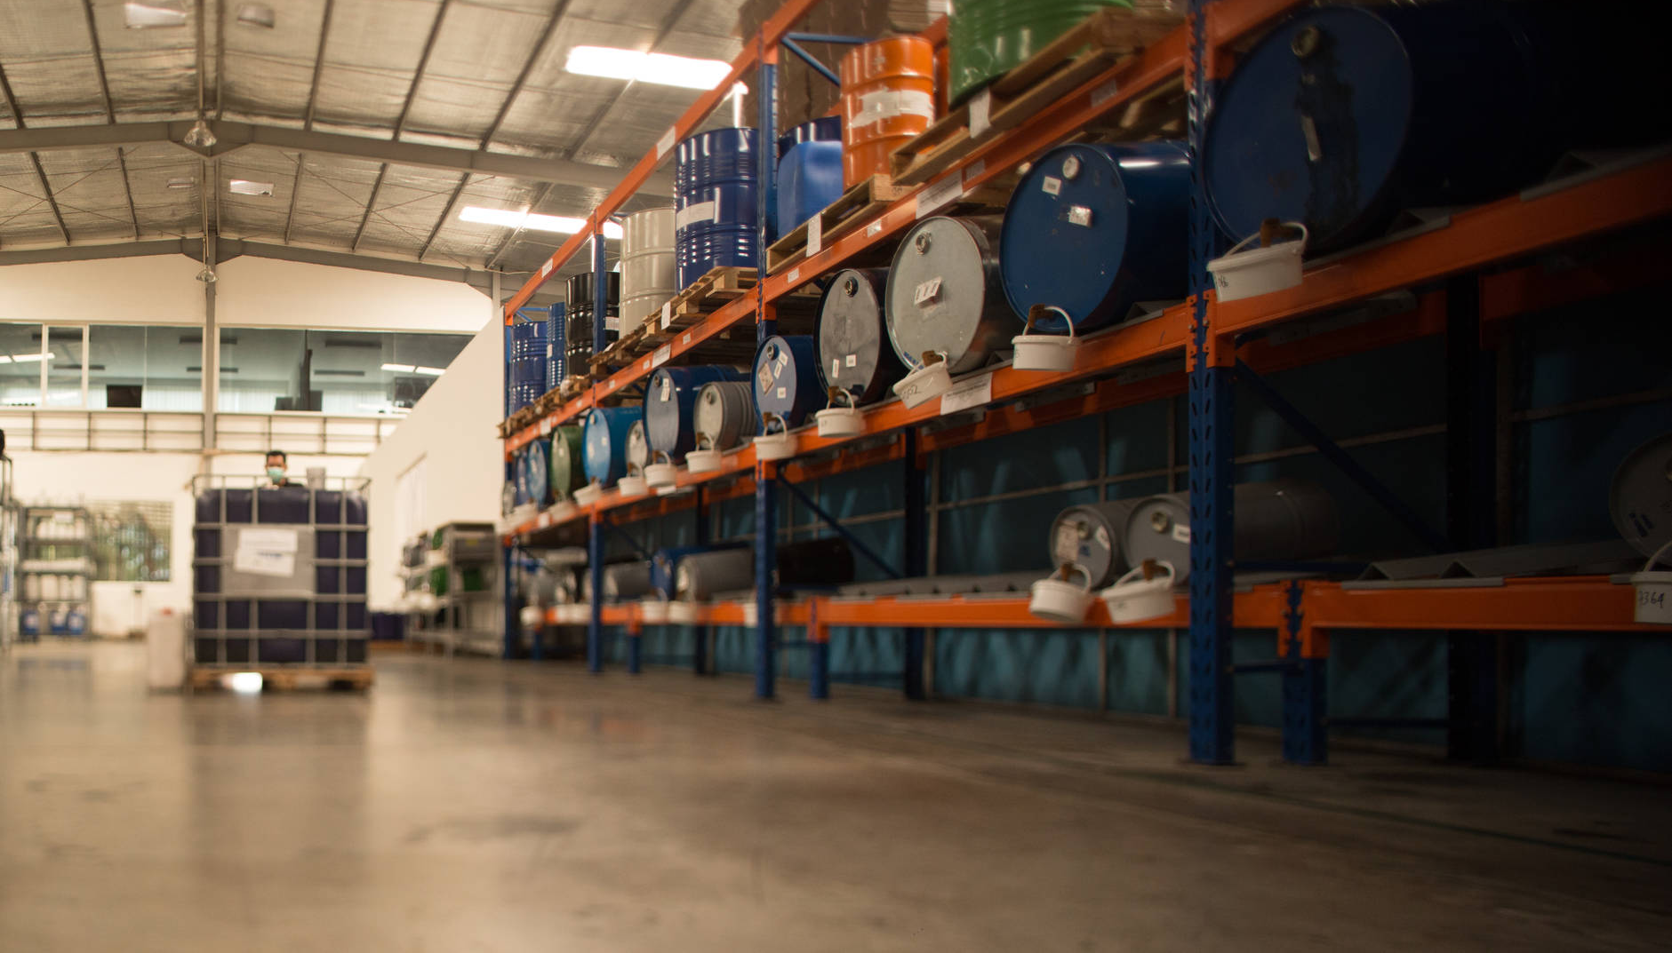

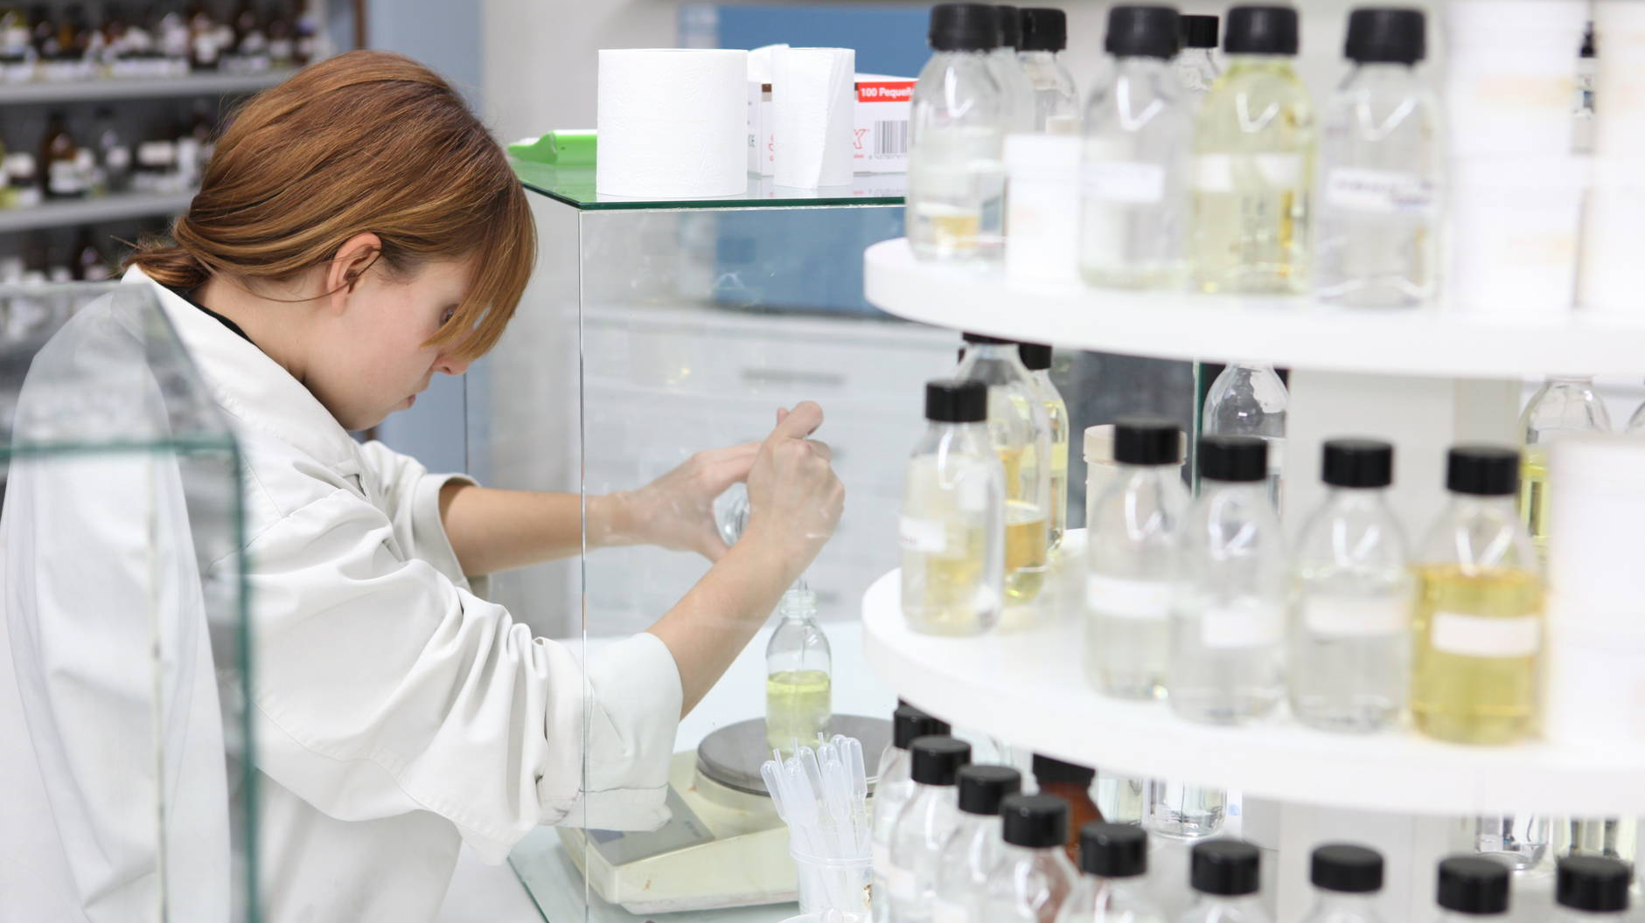
Time to
Collaborate
FOCUS: Our Business Team helps for looking for the trends of every market to assure the best results to our customers
REACH: We can provide more than 10.000 different high quality scents thanks to our internationally recognized team of perfumers.

Slide 25
T H A N K Y O U

